Slide 1
Chapter Three

Slide 2
F(a, b, c) = ac + ab’ + a’bc + a’b’c’

Slide 3
F(a, b, c, d) = ab’c’ + abd + ab’cd’

Slide 4
F(a, b, c, d) = (a + c + d)(a + b’ + c)(a + b’ + c’ + d)

Slide 5
F(a, b, c) = (a + b + c)(a + b’ +c)(a’ + b’ + c)(a + b + c’)

Slide 6
Things to note
The complexity of an implementation is directly related to the complexity of the algebraic expression.
The truth table for any equation is unique.
An equation can only have one truth table.
However the algebraic expression can vary.

Slide 7
Gate level Minimization
Is the design task of finding an optimal gate-level implementation.
Well-understood task
Manual methods become difficult
Many inputs/literals
There are tools that can help

Slide 8
Algebraic Manipulation
No set methods
No specific rules to determine next step

Slide 9
The Map Method
AKA
Karnaugh Maps
K-maps
The map (diagram) consists of squares.
Each of which represents a minterm of a function.

Slide 10
Any function can be represented as a sum of minterms
Therefore if a K-map is a diagram made of squares each of which represents a minterm,
Then any function can be represented with a K-map.
Which is a visual representation of the function

Slide 11
The simplest algebraic expression is one with the minimum number of terms and the smallest possible number of literals in each term.
Produces the design with a minimum number of gates and the minimum number of inputs.

Slide 12
The simplified expressions which result from a K-map are always in one of the two standard forms
Sum of products
Product of sums

Slide 13
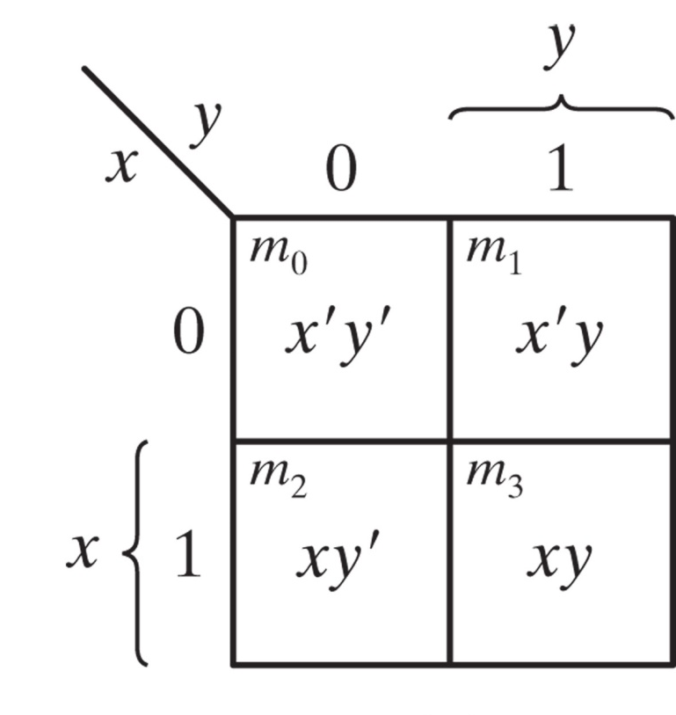

2-variable map

Slide 14
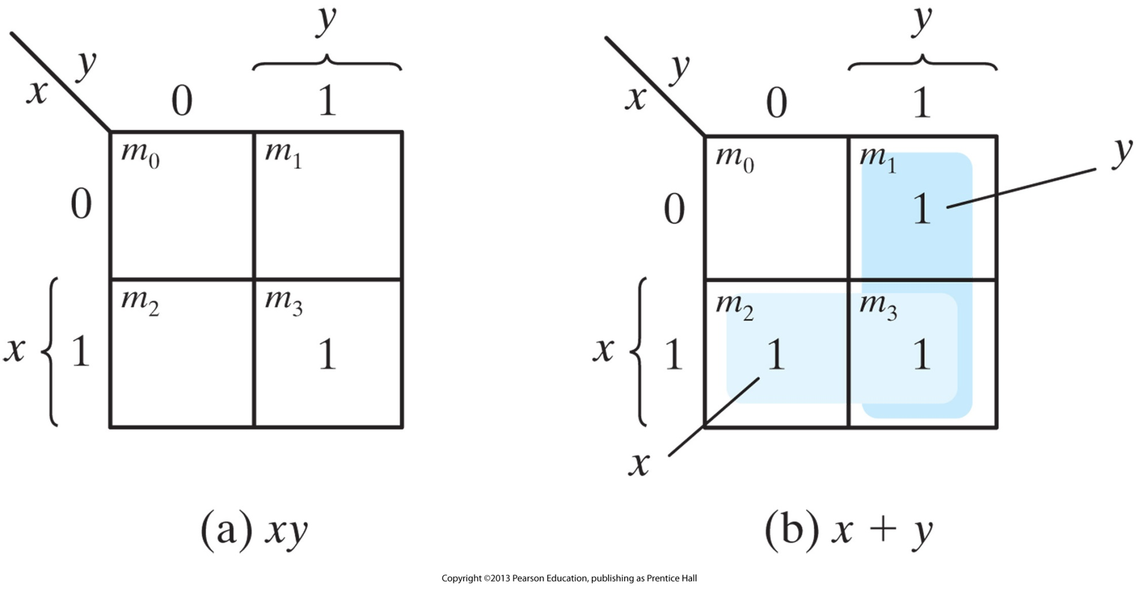
AND/OR K-Map

Slide 15
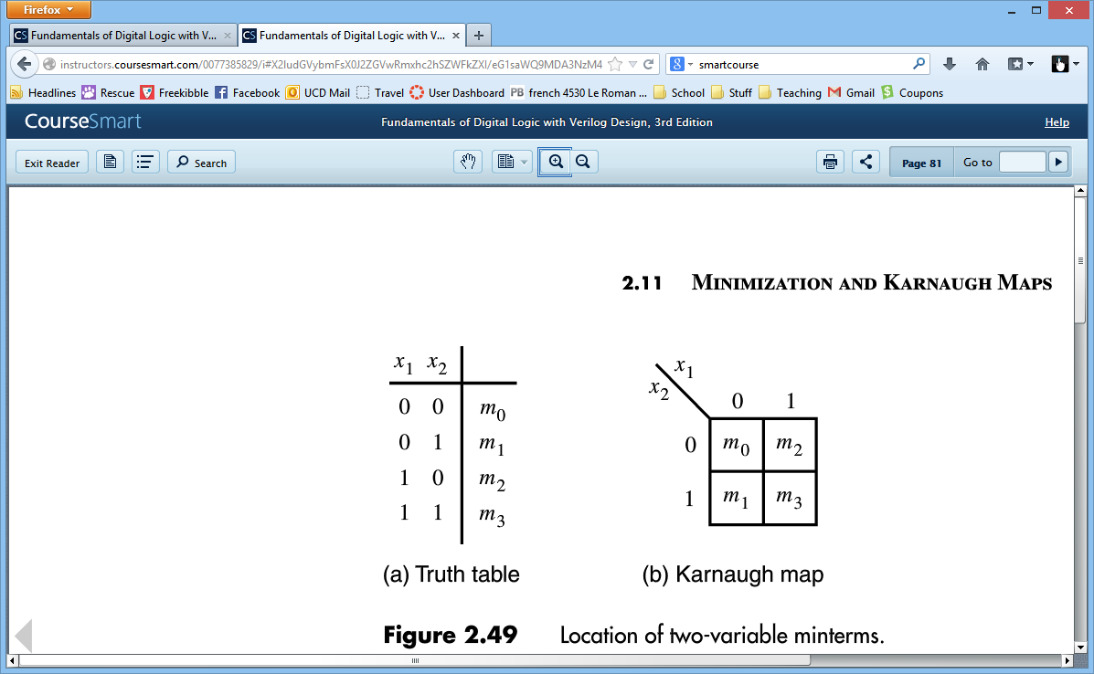
00
10
01
11

Slide 16
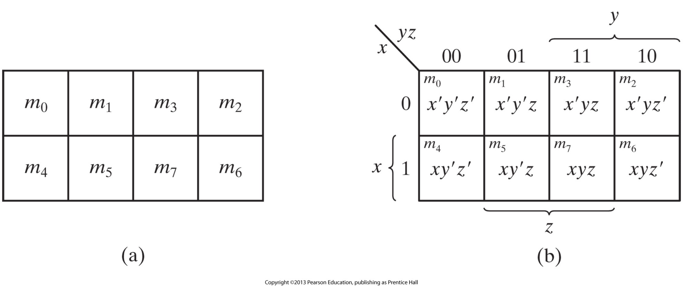
Three Variable K-map

Slide 17
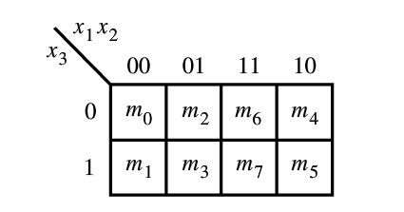
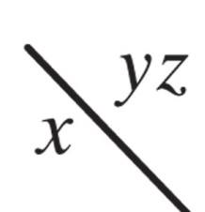
Example 3.1
F(x, y, z) = ∑(2, 3, 4, 5)

Slide 18

F=x’y + xy’

Slide 19
F(x, y, z) = ∑(3, 4, 6, 7)

Slide 20
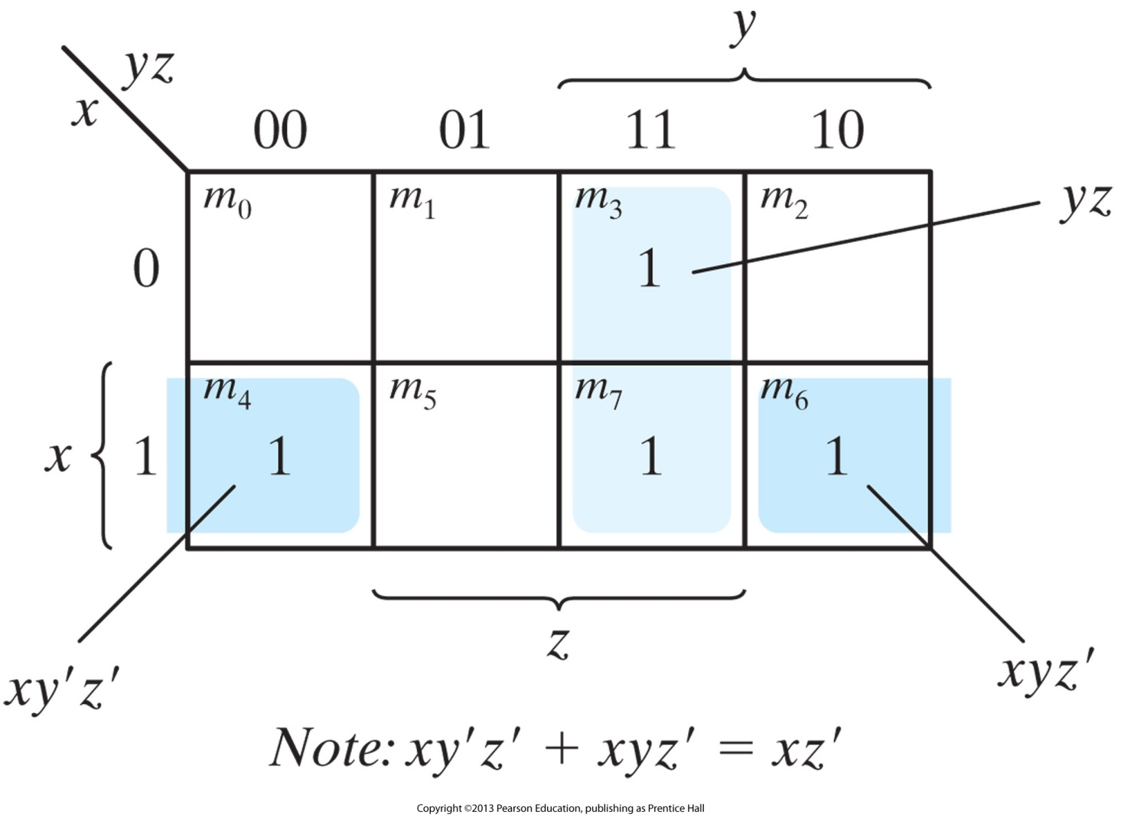

Slide 21
F(x, y, z) = ∑(0, 2, 4, 5, 6)

Slide 22
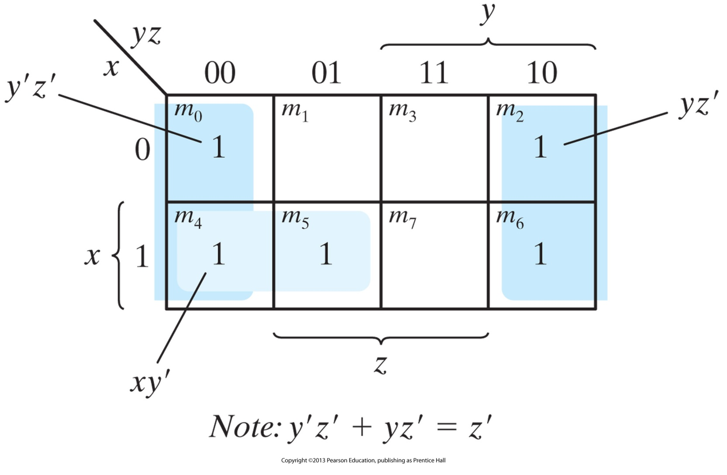

Slide 23
Things to note
1 square
1 minterm (3 literals)
2 adjacent squares
a term with 2 literals
4 adjacent squares
a term with 1 literal
8 adjacent squares
the function is always equal to 1

Slide 24
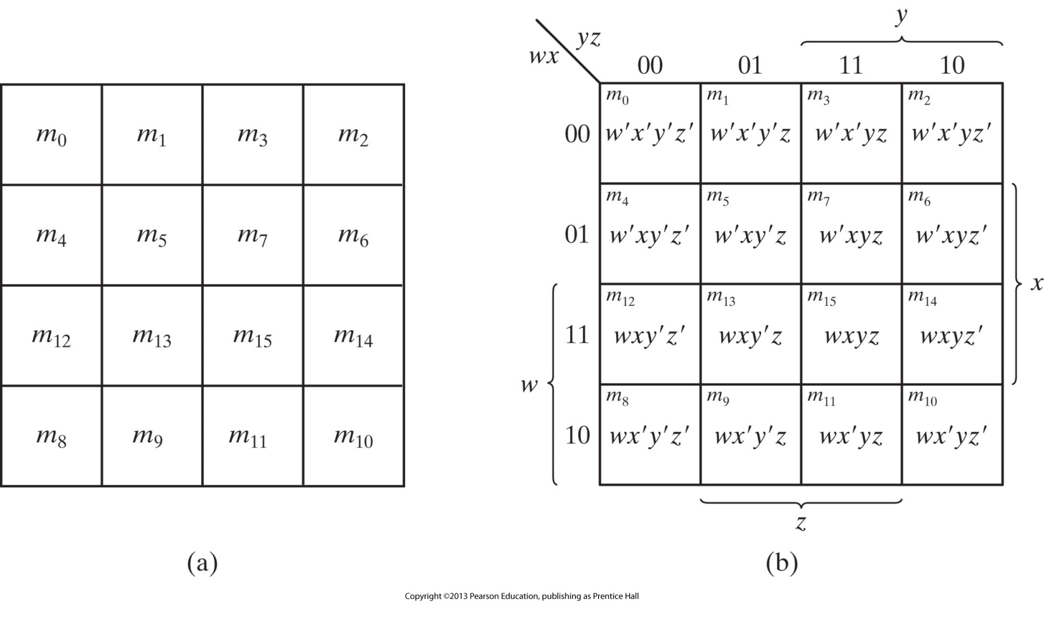
Four Variable K-map

Slide 25
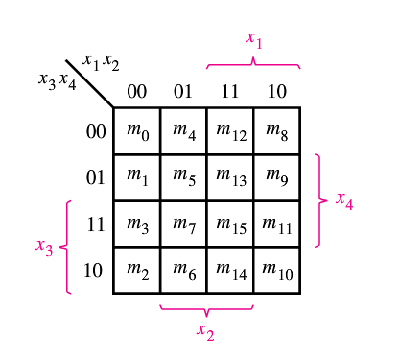
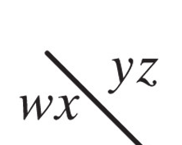
F(w, x, y, z) = Σ(0, 1, 2, 4, 5, 6, 8, 9, 12, 13, 14)

Slide 26


Slide 27
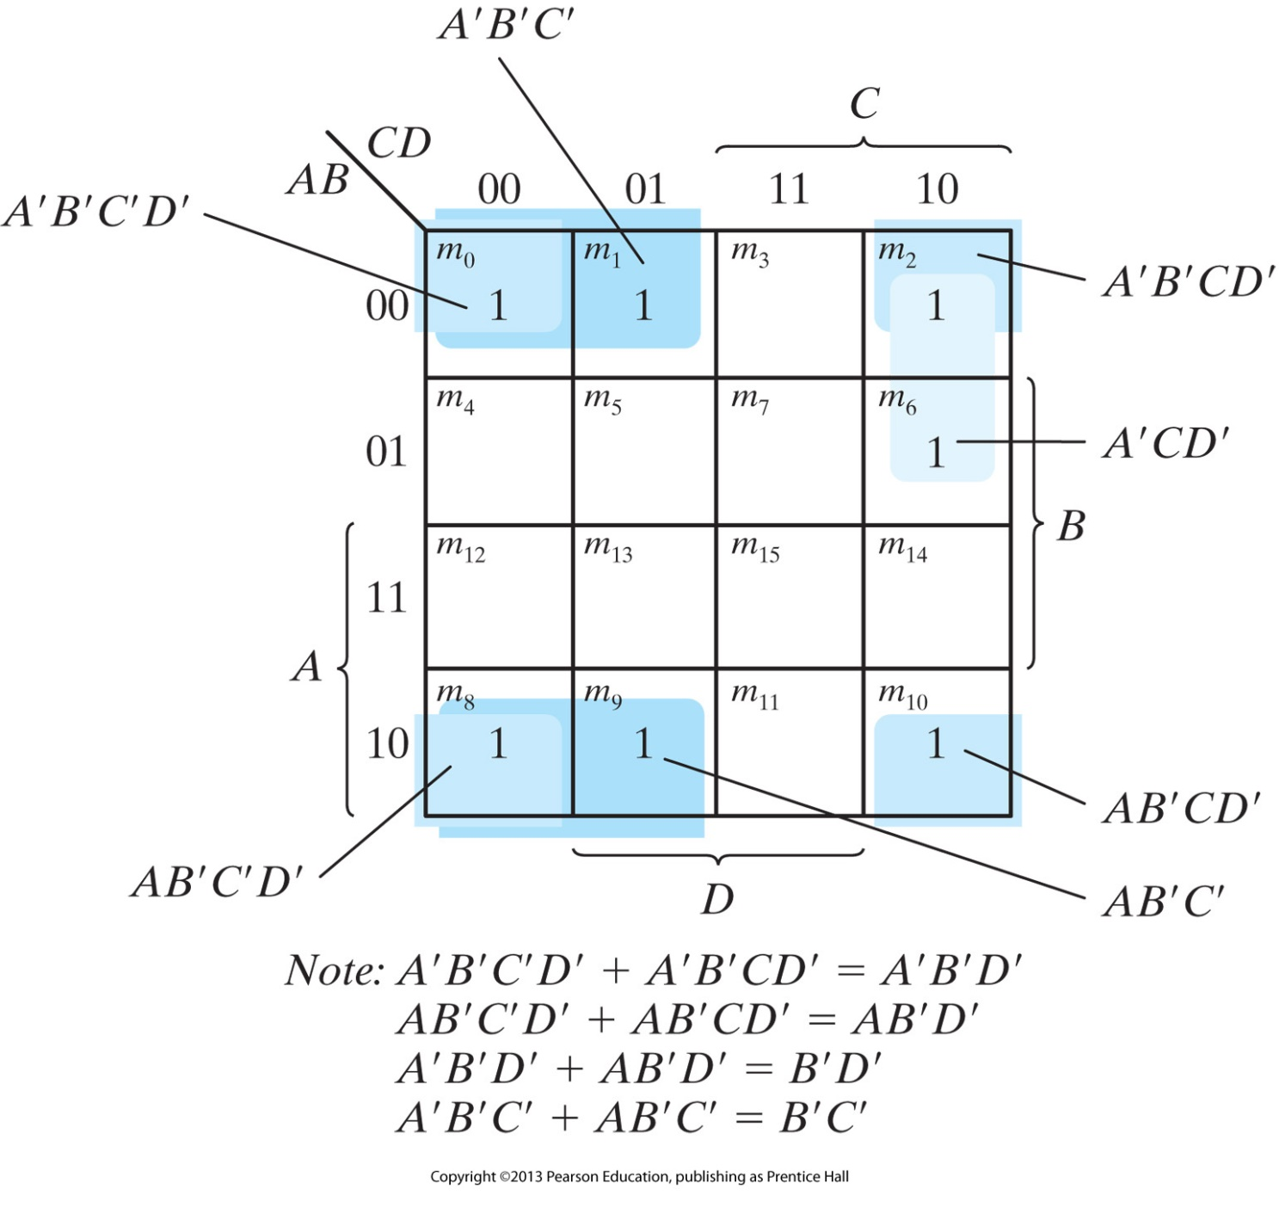
F(A, B, C, D) = A’B’C’ + B’CD’ + A’BCD’ +AB’C’

Slide 29
1 square
1 minterm (4 literals)
2 adjacent squares
a term with 3 literals
4 adjacent squares
a term with 2 literals
8 adjacent squares
a term with 1 literal
16 adjacent squares
the function is always equal to 1

Slide 30
Prime implicant – a product term obtained by combining the maximum possible number of adjacent squares in the map
“The Bigger the Better”
Essential prime implicant – a prime implicant which is the only one to cover a given square.

Slide 31
F(A, B, C, D) = ∑(0, 2, 3, 5, 7, 8, 9, 10, 11, 13, 15)

Slide 32
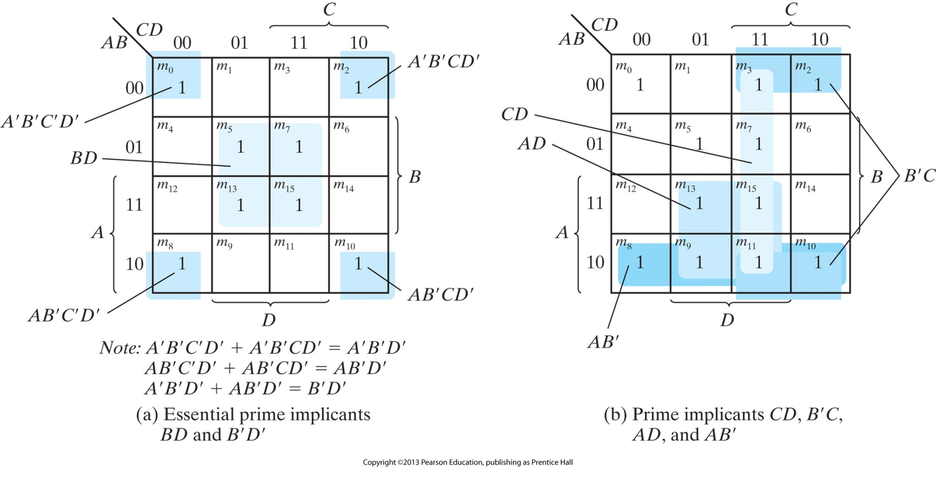

Slide 33
Process of finding a min cost circuit
Generate all prime implicants for the given function f.
Find the of essential prime implicants
If the set of essential prime impicants covers all valuations for which f = 1, then this set is the desired cover of f.
Otherwise determine the non-essential prime implicants that should be added to form a complete minimum-cost cover.
Notes:
The choice of non-essential prime implicants to be included in the cover is governed by the cost considerations. Often not obvious.

Slide 34
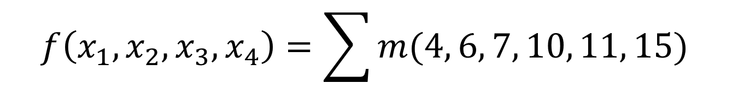
$$f\left(x_{1},x_{2}, x_{3}, x_{4}\right)=\sum{m(4, 6, 7, 10, 11, 15)}$$
0
1
0
0
0
0
0
0
0
1
1
1
0
1
0
1

Slide 35
$$f\left(x_{1},x_{2}, x_{3}, x_{4}\right)=\sum{m(4, 6, 7, 10, 11, 15)}$$
0
1
0
0
0
0
0
0
0
1
1
1
0
1
0
1

Slide 36
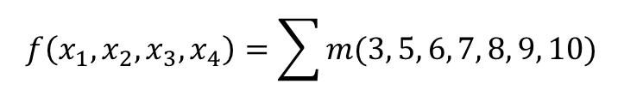
$$f\left(x_{1},x_{2}, x_{3}, x_{4}\right)=\sum{m(3, 5, 6, 7, 8, 9, 10)}$$
0
0
0
1
0
1
0
1
1
1
0
0
0
1
0
1

Slide 37
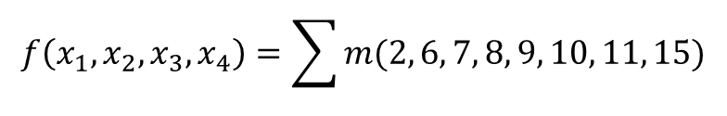
$$f\left(x_{1},x_{2}, x_{3}, x_{4}\right)=\sum{m(2, 6, 7, 8, 9, 10, 11, 15)}$$
0
0
0
1
0
0
0
1
0
1
1
1
1
1
0
1

Slide 38
$$f\left(x_{1},x_{2}, x_{3}, x_{4}\right)=\sum{m(2, 6, 7, 8, 9, 10, 11, 15)}$$
0
0
0
1
0
0
0
1
0
1
1
1
1
1
0
1

